Slide 1
Thursday 9/22 Warm-Up: OPTIC

Slide 2
The Boat Journey
Read the short excerpt from Humans of New York.
The Boat Ride through the Eyes of a Little Girl: https://www.youtube.com/watch?v=UDy8_8L3s0A
The Refugees’ Journey Across the Mediterranean: https://www.youtube.com/watch?v=nH4NExijRpk

Slide 4
Article: Image of Drowned Syrian Boy… Brings Migrant Crisis into Focus
Read the article.
Add at least 20 quality annotations as we read (thoughts, comments, reactions, questions, etc.)

Slide 5
Turn in Today
Google Work #3
Project Step 1
*You should conduct your interview OR use the online source and your imagination to fill out the entire documentation sheet ASAP. The documentation sheet is proof of this and is due by Thursday, October 6. Aim for turning it in a day early. Do NOT procrastinate!

Slide 6
Friday 9/22 Warm-Up: Journal
If you were a refugee, what are 5 questions you would ask?
Answer your questions.

Slide 7
Immigrants and Refugees One-Pager
Either read one of the stories that Ms. Yeganegi has about an immigrant or a refugee OR create your own character (that includes a name, age, home country, description of push/pull factors, what happened to them on their journey, where they are now, etc.)
Create a one-pager that tells their story in an informative and visually appealing manner.
Make sure the following information is included:
Name
Age
Home Country
Immigrant or Refugee and Why
Description of Experiences (push/pull factors, what happened on their journey, where they are now)
Include at least three visuals.
Include at least two quotes.
This all must go one ONE side of your white paper.

Slide 8
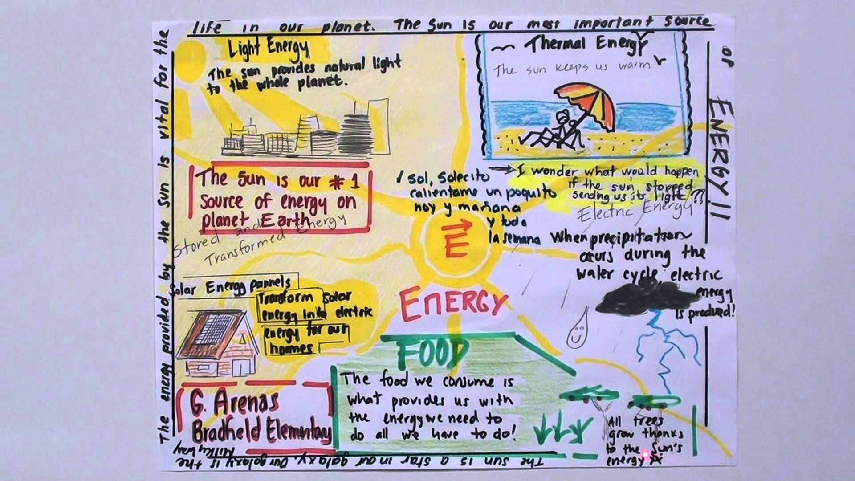

Slide 9
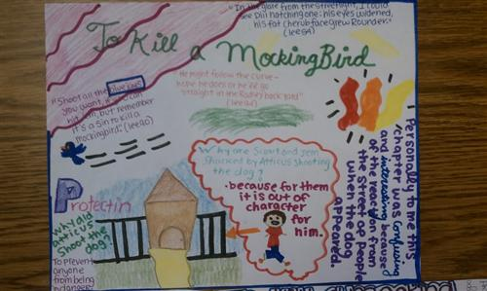

Slide 10
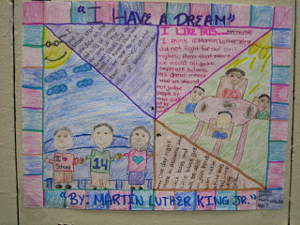

Slide 11
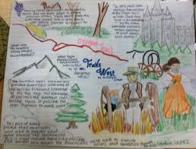

Slide 13
Immigrants and Refugees One-Pager
Either read one of the stories that Ms. Yeganegi has about an immigrant or a refugee OR create your own character (that includes a name, age, home country, description of push/pull factors, what happened to them on their journey, where they are now, etc.)
Create a one-pager that tells their story in an informative and visually appealing manner.
Make sure the following information is included:
Name
Age
Home Country
Immigrant or Refugee and Why
Description of Experiences (push/pull factors, what happened on their journey, where they are now)
Include at least three visuals.
Include at least two quotes.
This all must go one ONE side of your white paper.

