Slide 1
Warm-Up
Review graphic novel terms and concepts from p. 55 (handout from yesterday).
You MUST know these terms and be able to apply them!

Slide 2
The Monkey King
http://www.humblecomics.com/monkey/
http://geneyangabc.wordpress.com/monkey-king/

Slide 3
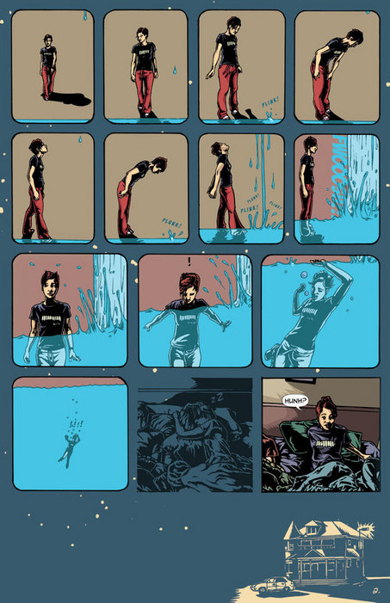
How to Read a Graphic Novel Page
Graphic novels are read left to right, just like traditional texts

Slide 4
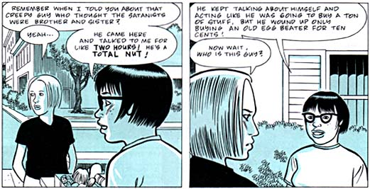
Dialog Balloons
dialog balloons are read left to right or top to bottom as is appropriate.
1
4
2
3
5

Slide 5
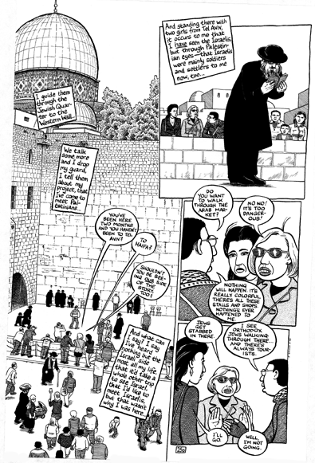
Sometimes it can get a little more complicated…

Slide 6
2
1
But the basic left to right rule still applies to panels
3
4

Slide 7
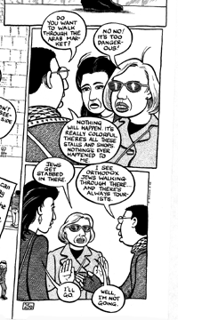
2
and dialog balloons as well
1
3
4
5
6
7

Slide 8
Time to Read
Why is having a book important?
Reading Questions – counts as quiz grades!

Slide 9
Peer Notebook Checks
Trade your notebook with a partner.
Grade the WHOLE notebook.
Use the grading log in the front as a guide to what you’re looking for.
Record the grade on the log. Make sure you put your name.
Put the person’s (whose notebook you graded) name and grade on a post-it note and return to Ms. Y.

